Slide 1
How to Market Using Social Media
Mike Auten
Director of Web Systems Services

Slide 2
What we’re doing here
My Mission
My Background
Your Background
Share my knowledge
Grow Your Skills
Your next steps
Media Calendar
Present a Challenge
Wrap-up
Thanks!

Slide 3
My Mission - #1
Why am I here speaking to you?

Slide 4
The Questions
How does IAAP recruit new members using social media?
How do we engage with the traditional college age person?
How can we create the most value with the least amount of work?

Slide 5
My Background - #2
Professional Experience

Slide 6
Qualifications
Experience
Relevance
Interests
Notes:
Experience – over 12 years in online marketing, social media, understanding technology
Relevance – research trends,
Interests – create niche websites, test out new ideas, go geek

Slide 7
Audience assessment - #3
Platforms in use
Posting Frequency
Level of Ability

Slide 8
Platforms
Facebook
Twitter
LinkedIn
Google+
YouTube
Pinterest
Blog

Slide 9
Frequency of Posts
24x7x365
All the time at work
Some of the time
When I get around to it
I think I have an account

Slide 10
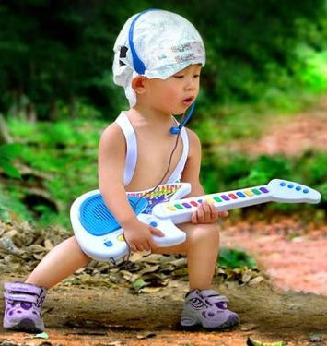
Level of Ability
Rock star
Backup Band
#1 Fan
I see them when they are in town
I don’t like that kind of music

Slide 11
Engagement
Producer
Consumer
Notes:
80 – 20 rule is in effect
80% read
20% write

Slide 12
What I’ve learned - #4
How the online world works

Slide 13
Basics of search engines
Index Content
Rank Content
Display Search Results
Where does your content end up?
Analyze the results
Notes:
When people search for things, the search engine tells them what is most relevant. In order to be important, you must be found. In order to be found, you must be reliable and good.
Analyzing results

Slide 14
Basics of social media
Find like-minded people
Share content that interests people
Consume content that others find interesting
How does your content get shared?
Notes:
Sharing Content

Slide 15
Basics of marketing
Get people interested in what you want
Get people to take action
How to write great content
How well does your message perform?
Notes:
Writing Content

Slide 16
Tie it all together
Notes:
Writing Content – marketing
Sharing Content – Social Media
Tracking Results – Search engines

Slide 17
Making a good post - #5
Tips for Writing Effective Content

Slide 18
Provide Information
Offer something of value
Facts are great – opinions are valuable
Tell how you are using, doing, enjoying, etc… it!
Example: I’m going to the IAAP Conference to learn about Marketing and Social Media.

Slide 19
Include Images
Bigger is Better
Know the limits of your platform
Add a logo if its relevant
Notes:
Bigger is better – higher resolution, fill the page, professional photos are best,
Know limits – dimension restriction or file size too big
If you’re posting on pinterest, don’t post faces
Anywhere else, it’s ok

Slide 20
Provide a Link
References (What’s your source?)
Registration information
Use informative anchor text for a link
Example: I’m going to the IAAP Conference to learn about Marketing and Social Media.
Notes:
Reference: Digital citizen – citing sources of information, researching correct content
Registration Info: what if they want to join you? Make it easy to participate
Anchor text: #1 most used link text? Click Here. Not descriptive
Try: Join Me, Register for the Event, Action words

Slide 21
Engage with Users
Respond to responses
Dialogue helps everyone learn
And boosts rankings!
Draw them out
Open ended questions

Slide 22
Shorten URL’s
Long addresses take up too many characters
Use Bit.ly or any of the built in services

Slide 23
Call to Action
Tell readers what you want them to do
Never leave them guessing
Example:
JOIN ME at the IAAP Conference and learn about Marketing and Social Media.

Slide 24
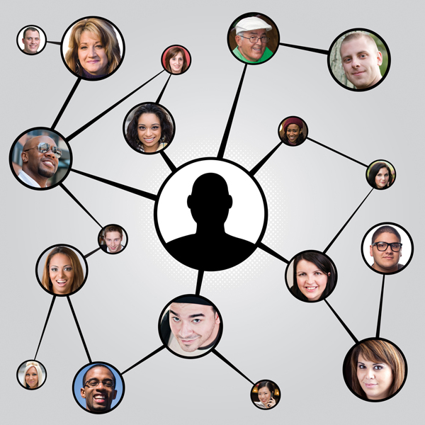
Tag Brands and People
They are notified – and may interact with you
Bigger circle = more potential
Example:
JOIN ME at the @IAAP Conference and learn about Marketing and Social Media.
Notes:
Explanation: @Someone
Retweet your favorite person but add to it

Slide 25
Use #Hashtags
#HashTags are a way to classify information
Visitors can group things together and find other similar information
#Don’t #overdue #it #!
Example:
JOIN ME at the IAAP Conference and learn about #Marketing and #Social Media.

Slide 26
Engage the Community
The more you engage IAAP members, the better the results
Example:
JOIN ME and @Diane Hanel at the IAAP Conference and learn about #Marketing and #Social Media.

Slide 27
Participate in Trending Topics
Most people are interested in current events
Guaranteed wide audience
Only if they are relevant

Slide 28
Add Value
See themselves as members
People join that are like them

Slide 29
The Good Times and The Bad Times
 | Best Time to Share | Worst Time to Share
Facebook | 1pm – 4pm | 8pm – 8am
Twitter | 1pm – 3pm | 8pm – 9am
Pinterest | 2pm – 4pm | 5pm – 7pm
 | 8pm – 1am
Google + | 9am – 11am | 6pm – 8am
LinkedIn | 7am – 9am | 10pm – 6am
 | 5pm – 6pm
Notes:
Thursdays and Fridays are most popular

Slide 30
Level of Effort
How fast do you write?
How much time do you have?
Do you practice?
What type of impact do you want to make?
Is it important to you?
Notes:
How long does it take to do all of this? Well, that depends
Fast: if you’re a writer, then longer posts are ok – if not, stick with the shorter posts
Time: Set a schedule and stick to it – make it part of your daily routine
Practice: like anything else, the more you practice the better you get – the faster you get, the easier it is
Impact: the better you get, the easier it is, the more tips you can try out, the better you get, etc.
Importance: A little effort can go a long way for something you enjoy doing

Slide 31
How can I help IAAP? - #6
What can I do to draw in new members?
Notes:
Dissected the IAAP website for ideas that are relevant
The more you interact and discuss the website, the more visible it is

Slide 32
Promote a webinar
Register for an IAAP sponsored webinar
Write a post about what you want to learn
Link to the webinar in your post so others can register
Remind your followers on social media as the time gets closer
Do a follow-up post to discuss what you learned

Slide 33
Talk about Membership
Talk about the different options for membership
Post about why you became a member
Discuss with others the value of membership
Always post a link

Slide 34
Promote a book
Read a book from the IAAP shop
Write a review of the book
Post the review online with a link back to the IAAP shop

Slide 35
“Like” What You Read
When you read an article on the IAAP site, make sure to “Like” it.

Slide 36
Encourage Certification
Post about your own certification
Discuss the benefits of being certified

Slide 37
10 Ideas for Posts
A blog post / article you read that is relevant to IAAP
A useful tool you use in your work – or a software tip that you just learned
A new app you downloaded and tried (whether you liked it or not doesn’t matter)
Someone you follow on Social media and why – or something they said that made you think (Post a link to it for extra exposure and “bonus points”)
A great tutorial you used in your work – include a link to it or at least a shout out to the author
A risk you took at work and how it turned out
A new process or procedure that you created/changed and how it is working
Ask for advice on a problem or decision from work
Share a goal and outline how you plan to achieve it.
Discuss something you are going to change about your routine at work to make you more successful

Slide 38
10 More Ideas for Posts
Discuss a new project you are involved in – and what the outcomes should be. Follow up when the project is finished and document how well you did or what you should do different
INFOGRAPHIC – create one or link to one that is relevant to you and your work
Describe your average day and the types of things you do. This will give someone looking to go into your field an idea of what to expect.
Discuss a workshop or training that you went to. What did you learn, who did you meet, will you go back next year?
Interview another member about their biggest challenges at work and how they plan to overcome them – can resources from IAAP help?
Make a Top Ten list about why you are a member of IAAP
Create a list of things to do to get better at a skill that IAAP can help with
Interview another member and find out why they joined the group and what they see as the biggest selling point
Post a comment on another members’ blog on the IAAP site
Do a Google search for Blog Post Ideas and become inspired!

Slide 39
SEO
Do I need to worry about it?
Include IAAP or International Association of Administrative Professionals in all of your communications
Notes:
Hot Topic – its easy to get too focused on SEO.
Keep it focused, easy to understand, and easy to share – you’ll do fine

Slide 40
media calendar - #7
Suggestions on What You Should Say and When

Slide 41
Weekly Schedule
Monday: Get an idea for a post – and get started!
Tuesday: Read and Respond to other members and other posts
Wednesday: Add other media to your post
Thursday: Finish writing and Make it Live!
Friday: Check stats and respond to comments
Notes:
Monday:
Tuesday:
Wednesday: links, graphics, photos, videos
Thursday:
Friday:

Slide 42
Other Ideas
Email footer
Pictures from Meetings or Gatherings
Make a video tutorial of something you learned as a member
Create a viral campaign!

Slide 43
the challenge - #8
Bring all of the pieces together – and go viral!

Slide 44
Book Seth Godin for 2015
Write up an invitation to have him come speak
Post it on the official IAAP page (so its legit)
Create a hashtag for the campaign #getSeth4IAAP
Each of you promote the post
Make sure to share it on Facebook, Twitter, LinkedIn – even Google+
Write about why he should come and speak
Discuss his previous work
Write reviews on his books – and link to them from the IAAP site
Come up with other ways to create exposure for your new cause
Measure your response

Slide 45
Wrap-up - #9
Write good content – make it shareable
Ask for what you want
Be Helpful
Stay Consistent
Have Fun
Go Viral

Slide 46
Thank You for your time!
Mike Auten
mikea@northeast.edu
www.mikeauten.com

